Slide 1
Development of Novel Algorithms
Exponential quantum speedup in simulating coupled classical oscillators
By Team: Quantum Cats
Mahroo Mirabdolhagh Hazaveh
Cynthia Cruz Sanchez
Johanna Nemec
Womanium Quantum + AI Project 2024

Slide 2
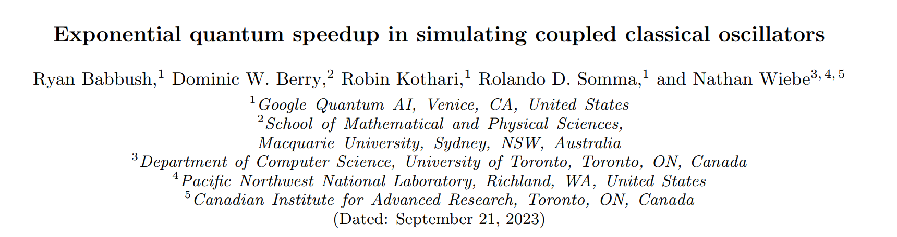
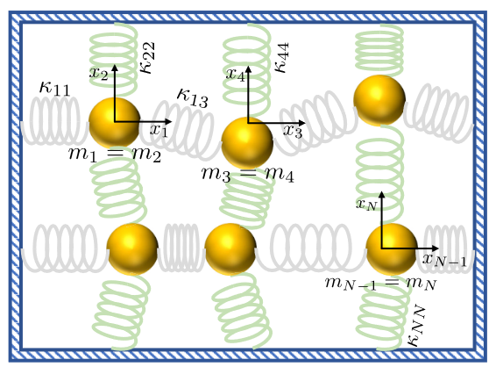
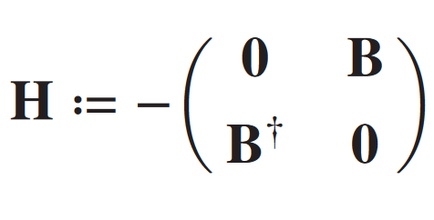
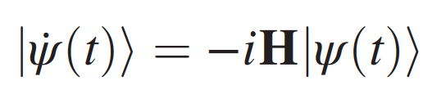
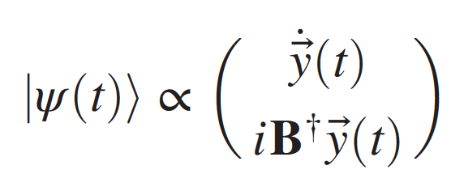
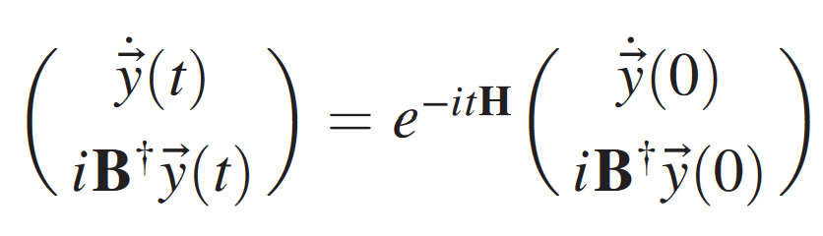
Problem Statement
Implementing algorithm of exponential speedup of harmonic oscillator based on simplification assumptions in the following paper and utilizing ClassiQ:
Fig 1 Oscillators - arXiv:2303.13012v3 [quant-ph]
key equations from paper - arXiv:2303.13012v3 [quant-ph]
Womanium Quantum+AI Project

Slide 3
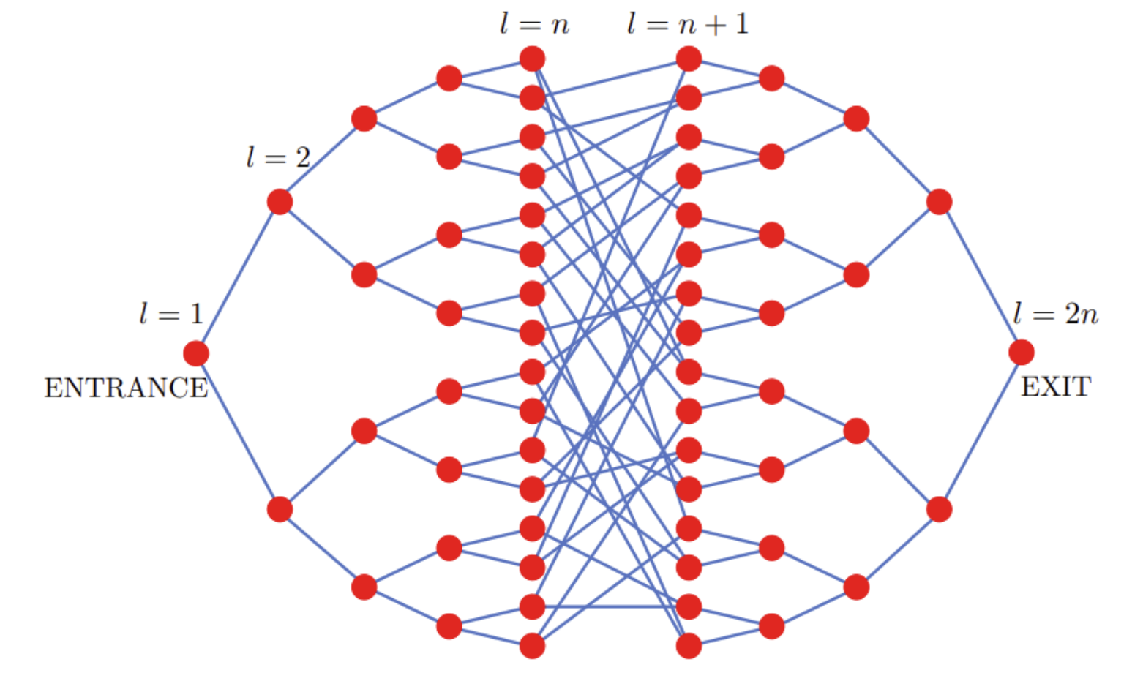
Project Solution Part I
Simple case of the Glued Tree Problem
Proof of concept
Initial state would set to zero
All the masses and the spring constants are equal to 1 for all the elements
Fig 2 Glued Tree Diagram arXiv:2303.13012v3 [quant-ph]
Womanium Quantum+AI Project

Slide 4
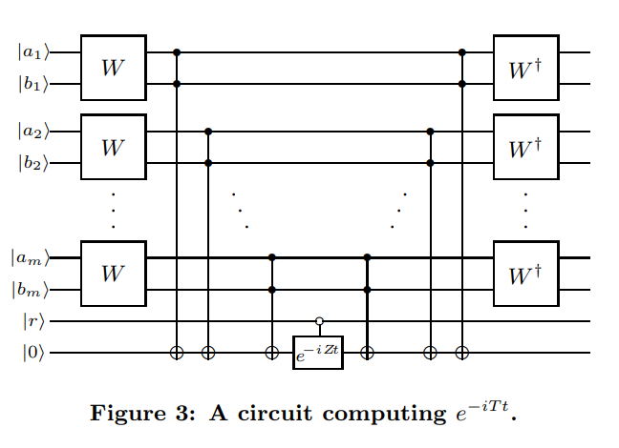
Project Solution Part II
Generalized Case
Access to Kappa Matrix, Mass Matrix, Position Matrix
Impacting the state preparation and the Hamiltonian Simulation
All the building Blocks represent the Grover Search
A set of Ancilla Qubits plus one Ancilla for the inequality test
arXiv:quant-ph/0209131v2
Womanium Quantum+AI Project

Slide 5


Success!
Members learned a lot, met knew friends, turned in a team project, & had fun!
Practiced literature review as sought additional outside sources, while tried to get a grasp of problem statement and other past work
Utilized Github for the first time
New contributing members to the quantum computing research community
Implemented theory into practice by coding a proposed quantum algorithm!
Quantum Harmonic Cats Team Github Repo
https://github.com/CynthiaCruzSanchez/Womanium-Project
Womanium Quantum+AI Project

Slide 6
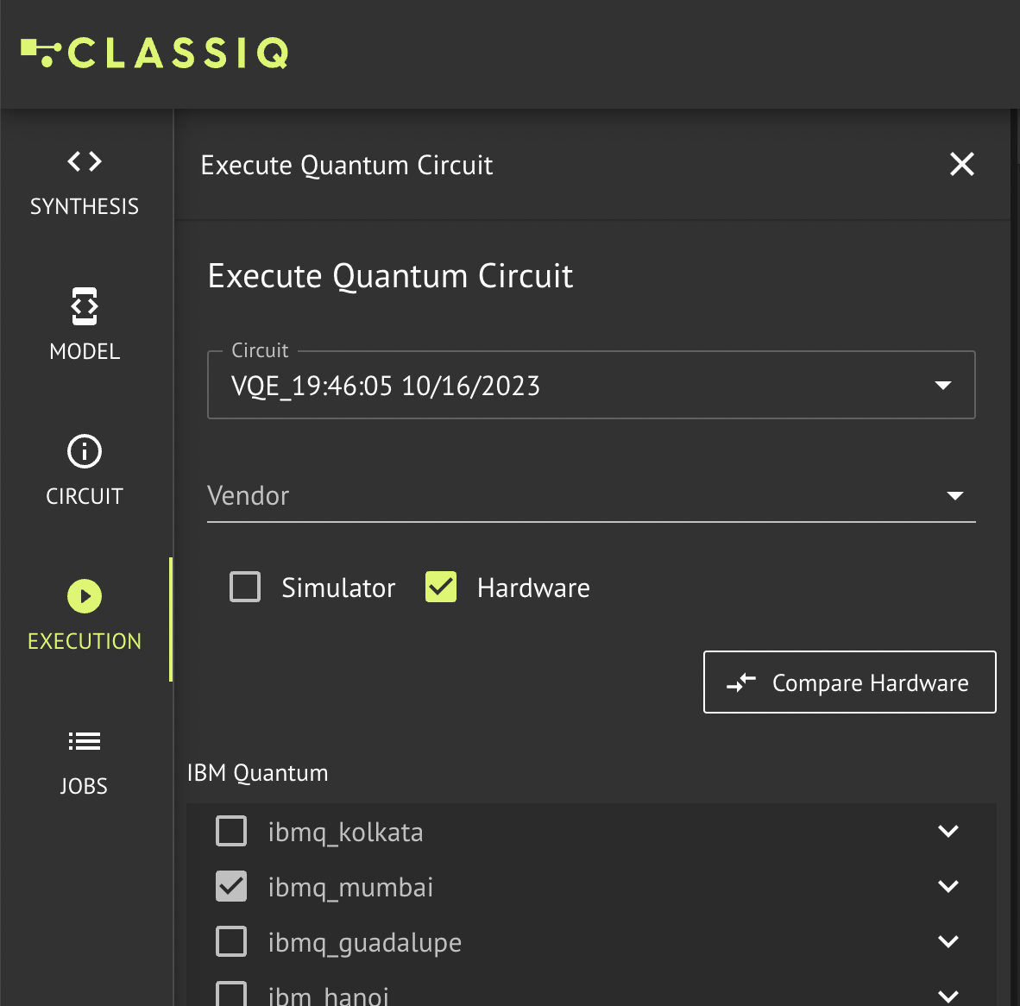
Future Scope
Run the expansion code on a simulator
Analyze result, edit and revise code
Repeat as many times necessary
Search for the optimal quantum computing hardware
Make code compatible with desired hardware
Implement algorithm on real computer
Will seek to discuss work with outside members to get expert feedback and input, as our beginner experience is our biggest limitation, and we want to ensure best possible work prior to utilizing quantum hardware resources.
ClassiQ Website www.https://www.classiq.io/
Womanium Quantum+AI Project

